Slide 1
C程式設計實驗(二)
Chapter4. Parameters and Overloading

Slide 2
Outline
Call - by - value and Call - by - reference
Overloading

Slide 3
Parameters
Two methods of passing arguments
Call - by - value
“copy” of value is passed
Call - by - reference
“address of” actual argument is passed

Slide 4
Call - by - value
顧名思義就是把實際的「值」複製一份給對方。
所謂複製便是對方拿了其值後，做任何修改皆不會影響原本的值。
還記得local variable嗎?

Slide 5
Call - by - reference
「參考」: 把自身的位址(address)給對方。
當對方改變數值，原來的也會改變。

Slide 6
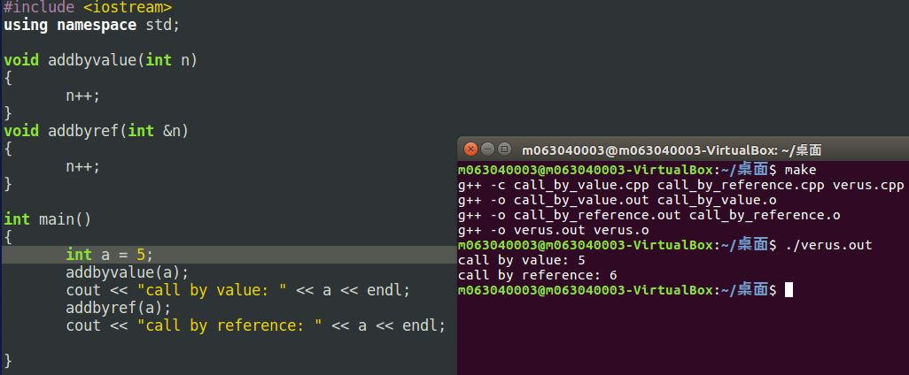
Call - by - value vs Call - by - reference

Slide 7
Overloading(多載)
當相同「函式名稱」有多種「函式定義」時，稱為Overloading
Given following functions:
1. void f(int n, double m); 2. void f(double n, int m); 3. void f(int n, int m);
These calls: f(98, 99); → Calls #3 f(5.3, 4); → Calls #2 f(4.3, 5.2);
→ Calls ???

Slide 8
Automatic Type Conversion and Overloading
double mpg(double miles, double gallons){ return (miles/gallons); }
Example function calls:
mpgComputed = mpg(5, 20);
Converts 5 & 20 to doubles, then passes
mpgComputed = mpg(5.8, 20.2);
No conversion necessary
mpgComputed = mpg(5, 2.4);
Converts 5 to 5.0, then passes values to function

Slide 9
Default Arguments
Allows omitting some arguments
Specified in function declaration/prototype
void showVolume(int length, int width = 1 , int height = 1);
Last 2 arguments are defaulted
Possible calls:
showVolume(2, 4, 6); //All arguments supplied
showVolume(3, 5); //height defaulted to 1
showVolume(7); //width & height defaulted to 1

Slide 10
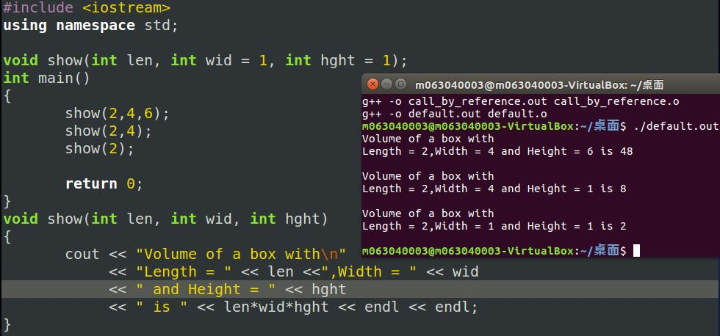
Example

